Slide 1

Crimp Machine

Slide 2
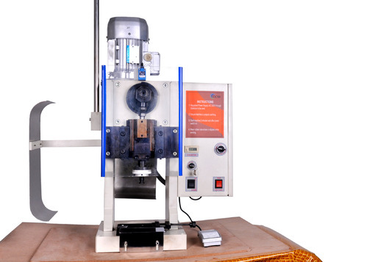
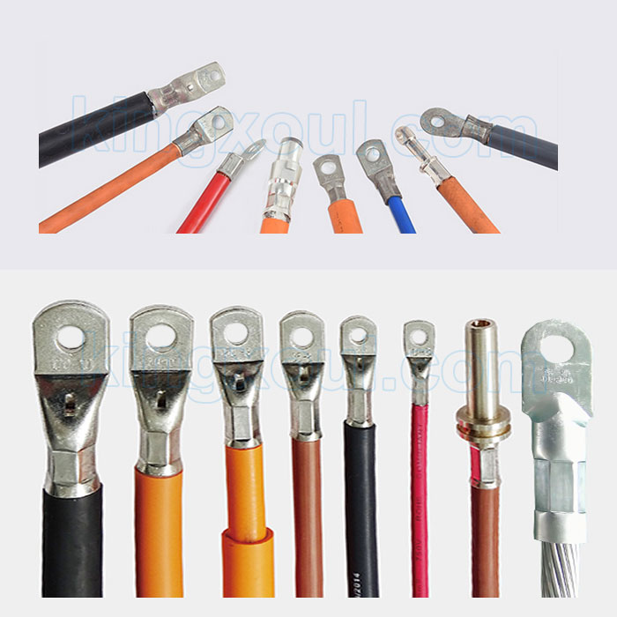
Crimp Machine
Wires after Crimping

Slide 3
Objectives:
The system used to control Crimp machine to be used only for 500 count , then stop the machine to make check and calibration , so the system monitor the operation the machine and count the usage.
The count number is stored in internal EEPROM to start from the last count when the Power off.
When the system reach 500 count he stop the machine and make alarm buzzer.

Slide 4
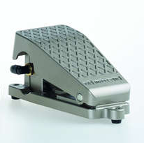
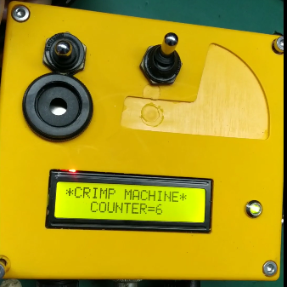
Process Flow chart:

Slide 5
Thank You

